Slide 1
PORRO Risk Relationship Ontology
Andrew McHugh
Pushing the Boundaries - Excellence in Digital Curation Education and Training Through Collaboration
Monday 1st October 2012

Slide 2
Background
Digital Preservation Trustworthiness:
How to build digital libraries/archives?
How to validate digital libraries/archives?
Digital Repository Audit Method Based on Risk Assessment
A tool and methodology for self-assessment of repositories based on risk management
Developed in DigitalPreservationEurope and Digital Curation Centre projects
Built upon solid foundation of research looking into how preservation repositories function, thrive & fail

Slide 3
An understanding of preservation
Assumption: preservation can be understood as a complex interrelationship of objectives, policies, activities, resources and rights/responsibilities.
Relating these can enhance understanding of risk causation and recovery
Capacity and capability to effectively manage risk can be considered synonymous with digital preservation success

Slide 4
An ontology for relating risk
Preserved Object and Repository Risks Ontology
To illustrate the relationships between factors that inform and influence the accomplishment of preservation goals:
Why?
To identify risks (based on common policies, infrastructure or contexts)
To facilitate risk resolution (with risks mapped to appropriate mitigation measures)
To perform gap analyses (with real world objectives aligned to modelled goals)
To illustrate function and relate to training needs?

Slide 5
Steps to develop an ontology
Initial focus on a series of repository evaluation reports undertaken in the development of DRAMBORA
Parse reports, isolating information which would become ontology elements then categorising them according to a corresponding objective
Developed a Semantic Mediawiki wiki to represent relationships between objectives and example institutions
Generalised elements in bespoke application categorised to conform to Cornell University’s three-legged stool model (organisation / technology / resources)

Slide 6
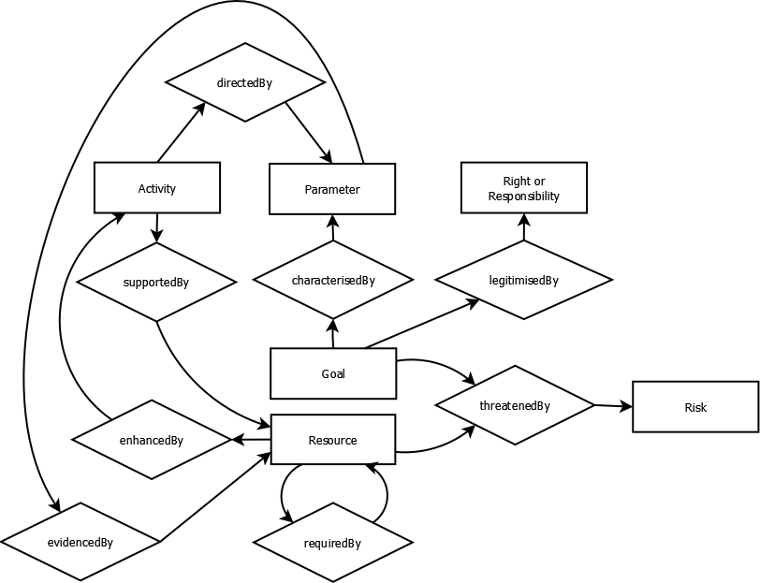
Ontology Structure
P..Goal
P..Activity
P..Parameter
P..Resource
P..Right / Responsibility
P..Risk

Slide 7
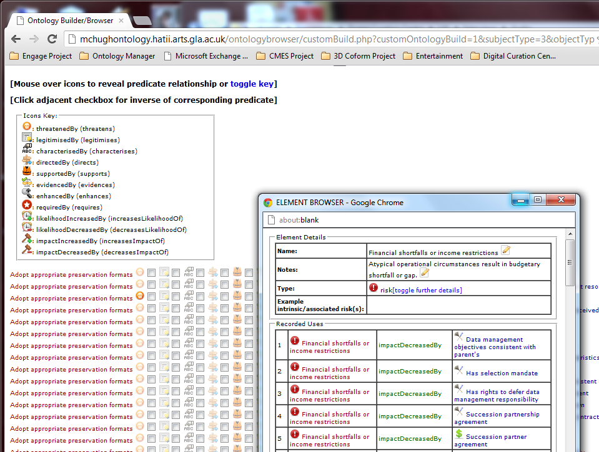
Ontology Browser

Slide 8
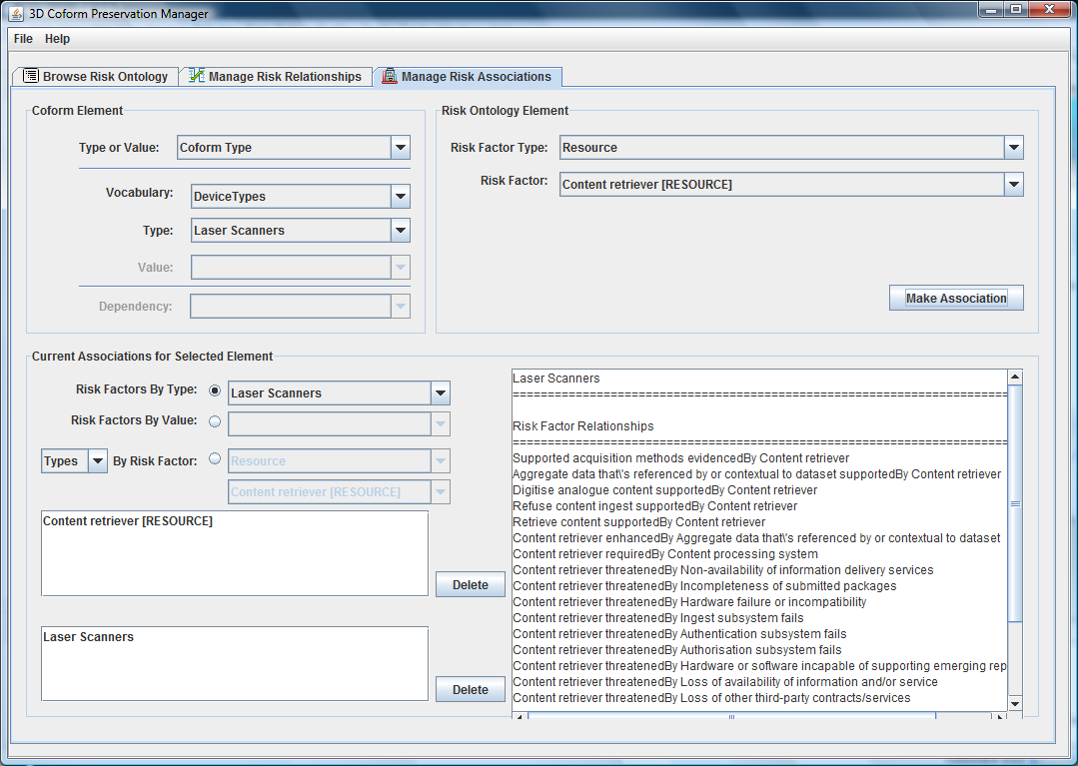
3D Coform Long Term Preservation Tool
Maps generic ontology to 3D content capture and management

Slide 9
Enhancing Best-practice Criteria
Examples:
Ensure documentation supports backwards tracing from DIPs to submitted originals
Define SIP in terms of required metadata
SIP consists of content plus appropriate manifest and permission statement
SIP describe in a table of contents
SIP may include a title
SIP may include additional archive identifiers
SIP may include affiliate-assigned identifier
SIP may include IDs of external metadata records
SIP may include issue number
SIP may include serial volume
SIP must identify range of codes included in data and their meanings, in MS Word, ASCII or DDI/XML
SIP must include codebook in electronic format describing contents of each variable
Ensure configuration of different AIP types is documented
Store metadata in corresponding AIP
Determine current version of content according to time of ingest
Support per-file property descriptions in file level metadata
Support plain text and rich text/pictorial documentation
Variable level metadata includes data definition statements
Variable level metadata includes technical information (e.g. data codebooks)
Study-level metadata includes high level abstracts
Study-level metadata includes metadata records describing study or collection as a whole
Study-level metadata includes study descriptions
TRAC Criterion: Define ingest package specification
Formalise (e.g. In Policy): | Relationship between ingest, archival and dissemination packages
 | Minimal required metadata
 | Package specifications
 | Metadata creation responsibility
 | Metadata creation workflow
Seek Legitimisation From: | Prescribed minimal metadata requirements
Consider Threatening Risks: | Extent of what is within the archival object is unclear
 | Shortcomings in semantic or technical understandability of information
 | Archival information cannot be traced to a received package
 | Loss of authenticity of information
 | Incompleteness of submitted packages
 | Structural non-validity or malformedness of received packages
 | Destruction of primary documentation
 | Loss of information provenance
Trustworthy Repository Audit and Certification Criteria and Checklist (TRAC)
PORRO reflects and greatly exceeds suggested example evidence provided by TRAC

Slide 10
Ontology Validation
Validated ontology by mapping to user submissions received via DRAMBORA online interactive tool (around 400 repositories are registered as users)
Similarly validated against repository evaluations and profiling activity led by US Center for Research Libraries
Mapped successfully to TRAC repository criteria

Slide 11
Thanks!
Questions are welcome.
Please contact me for more details (logins/questions/anything!):
http://mchughontology.hatii.arts.gla.ac.uk
andrew.mchugh@glasgow.ac.uk

